Slide 1
Object Oriented Paradigm
Lecture # 6

Slide 2
Outline
Class Fundamentals
Example: Box Class
Assigning Object Reference Variables
Adding a Method to the Box Class
Constructors
The this keyword
Garbage Collection
The finalize() Method

Slide 3
Class Fundamentals
The most important thing to understand about a class is that it defines a new data type
Variables defined within a class are called instance variables because each instance/object of the class contains its copy of these variables.
Thus, the data for one object is separate and unique from the data for another.

Slide 4
Class Fundamentals
The general form of a class:
  class ClassName {
  type instanceVariable1;
  type instanceVariable2;
  //…
  type instanceVariableN;
  type methodName1(parameterList){
  //body of method
  }
  type methodName2(parameterList){
  //body of method
  }
  //…
  type methodNameN(parameterList){
  //body of method
  }
  }

Slide 5
Example: Box Class
A class called Box defines three instance variables
  width, height, and depth
Currently, box does not include any methods
  class Box {
  double width;
  double height;
  double depth;
  }

Slide 6
Example: Box Class
Obtaining objects of a class is a two step process.
  Declare a variable of the class type.
    It is simply a variable that can refer to an object.
  Require an actual, physical object and assign it to that variable
    We can do this using the new operator
    The new operator dynamically allocates memory for an object and returns a reference to it
In Java, all class objects must be dynamically allocated
To create a Box object, we will use a statement like the following:
  Box mybox = new Box(); //creates a box object

Slide 7
Example: Box Class
Objects have physical reality
Every Box object will contain its own copies of the instance variables width, height, and depth
To access these variables, we will use the dot (.) operator
The dot operator links the name of the object with the name of an instance variable or a method
Example:
  mybox.width=100;

Slide 8
Example: Box Class
class Box {
double width;
double height;
double depth;
}
// This class declares an object of type Box.
public static void main(String args[]) {
Box mybox = new Box();
double vol;
mybox.width = 10;
mybox.height = 20;
mybox.depth = 15;
// compute volume of box
vol = mybox.width * mybox.height * mybox.depth;
System.out.println("Volume is " + vol);
}
}
Volume is 3000.0

Slide 9
Example: Box Class
Each object has its own copies of the instance variables.
This means that if we have two Box objects, each has its own copy of the instance variables (depth, width, and height).
It is important to understand that changes to the instance variables of one object have no effect on the instance variables of another.

Slide 10
Example: Box Class
// This program declares two Box objects.
class Box {
double width;
double height;
double depth;
}
public static void main(String args[]) {
Box mybox1 = new Box();
Box mybox2 = new Box();
double vol;
Program continues on next slide …

Slide 11
Example: Box Class
mybox1.width = 10;
mybox1.height = 20;
mybox1.depth = 15;
/* assign different values to mybox2's instance variables */
mybox2.width = 3;
mybox2.height = 6;
mybox2.depth = 9;
// compute volume of first box
vol = mybox1.width * mybox1.height * mybox1.depth;
System.out.println("Volume is " + vol);
// compute volume of second box
vol = mybox2.width * mybox2.height * mybox2.depth;
System.out.println("Volume is " + vol);
}
}
Volume is 3000.0
Volume is 162.0

Slide 12
Example: Box Class
A closer look at the two steps of object creation
Statement
Effect
Box mybox;
null
mybox
mybox = new Box();
width
mybox
height
depth
Box object

Slide 13
Assigning Object Reference Variables
Object reference variables act differently when an assignment takes place.
Example:
  Box b1 = new Box();
  Box b2 = b1;
Here, b1 and b2 will both refer to the same object.
The assignment of b1 and b2 did not allocate any memory or copy any part of the original object.
It simply makes b2 refer to the same object as does b1.
Thus, any changes made to the object through b2 will effect the object to which b1 is referring, since they are the same object.

Slide 14
Assigning Object Reference Variables
Box b1 = new Box();
width
b1
height
depth
Box b2 = b1;
Box object
b2
When we assign one object reference variable to another object reference variable, we are not creating a copy of the object, we are only making a copy of the reference.

Slide 15
Assigning Object Reference Variables
Although b1 and b2 both refer to the same object, they are not linked in any other way.
For example, a subsequent assignment to b1 will simply unhook b1 from the original object without affecting the object or affecting b2.
Example:
  Box b1 = new Box();
  Box b2 = b1;
  //…
  b1= null;

Slide 16
Adding a Method to the Box Class
// A method volume() that returns the volume of a box
class Box {
double width;
double height;
double depth;
// compute and return volume
double volume() {
return width * height * depth;
}
}

Slide 17
Adding a Method to the Box Class
class BoxDemo4 {
public static void main(String args[]) {
Box mybox1 = new Box();
Box mybox2 = new Box();
double vol;
// assign values to mybox1's instance variables
mybox1.width = 10;
mybox1.height = 20;
mybox1.depth = 15;
/* assign different values to mybox2's instance variables */
mybox2.width = 3;
mybox2.height = 6;
mybox2.depth = 9;
// get volume of first box
vol = mybox1.volume();
System.out.println("Volume is " + vol);
// get volume of second box
vol = mybox2.volume();
System.out.println("Volume is " + vol);
}
}

Slide 18
Adding a Method to the Box Class
Parameters allows a method to be generalized.
That is, a parameterized method can operate on a variety of data and/or be used in a number of slightly different situations.
Example
  int square() {
  return 10*10;
  }

Slide 19
Adding a Method to the Box Class
// This program uses a parameterized method.
class Box {
double width;
double height;
double depth;
double volume() {
return width * height * depth;
}
// sets dimensions of box
void setDim(double w, double h, double d) {
width = w;
height = h;
depth = d;
}
}

Slide 20
Adding a Method to the Box Class
class BoxDemo5 {
public static void main(String args[]) {
Box mybox1 = new Box();
Box mybox2 = new Box();
double vol;
// initialize each box
mybox1.setDim(10, 20, 15);
mybox2.setDim(3, 6, 9);
// get volume of first box
vol = mybox1.volume();
System.out.println("Volume is " + vol);
// get volume of second box
vol = mybox2.volume();
System.out.println("Volume is " + vol);
}
}

Slide 21
Declaring a Method with a Parameter (Cont.)
Notes on import Declarations
  Classes System and String are in package java.lang
    Implicitly imported into every Java program.
    Can use the java.lang classes without explicitly importing them.
    Most classes you’ll use in Java programs must be imported explicitly.

Slide 22
Declaring a Method with a Parameter (Cont.)
  Classes that are compiled in the same directory on disk are in the same package known as the default package.
  Classes in the same package are implicitly imported into the source-code files of other classes in the same package.
  An import declaration is not required if you always refer to a class via its fully qualified class name
    Package name followed by a dot (.) and the class name.

Slide 23
Instance Variables, set Methods and get Methods
Local variables
  Variables declared in the body of a particular method.
  When a method terminates, the values of its local variables are lost.

Slide 24
Instance Variables, set Methods and get Methods (Cont.)
A class normally consists of one or more methods that manipulate the attributes that belong to a particular object of the class.
  Attributes are represented as variables in a class declaration.
  Called fields (variables).
  Declared inside a class.
Instance variable
  When each object of a class maintains its own copy of an attribute, the field is an instance variable
  Each object (instance) of the class has a separate instance of the variable in memory.

Slide 25
Instance Variables, set Methods and get Methods (Cont.)
Every instance (i.e. object) of a class contains one copy of each instance variable.
Instance variables typically declared private.
  private is an access modifier.
  private variables and methods are accessible only to methods of the class in which they are declared.
Declaring instance private is known as data hiding or information hiding.
private variables are encapsulated (hidden) in the object and can be accessed only by methods of the object’s class.

Slide 26
Instance Variables, set Methods and get Methods (Cont.)
When a method that specifies a return type other than void completes its task, the method returns a result to its calling method.
Method setCourseName and getCourseName each use variable courseName even though it was not declared in any of the methods.
It can be used an instance variable of the class in each of the classes methods
The order in which methods are declared in a class does not determine when they are called at execution time.
One method of a class can call another method of the same class by using just the method name.
Link: http://underpop.online.fr/j/java/help/instance-variables-set-methods-and-get-methods-introduction-to-classes-and-objects.html.gz

Slide 27
Instance Variables, set Methods and get Methods (Cont.)
Unlike local variables, which are not automatically initialized, every field has a default initial value, a value which provided by Java when you do not specify the field’s initial value.
Fields are not required to be explicitly initialized before they are used in a program, unless they must be initialized to values other than their default values.
The default value for a field of type String is null

Slide 28
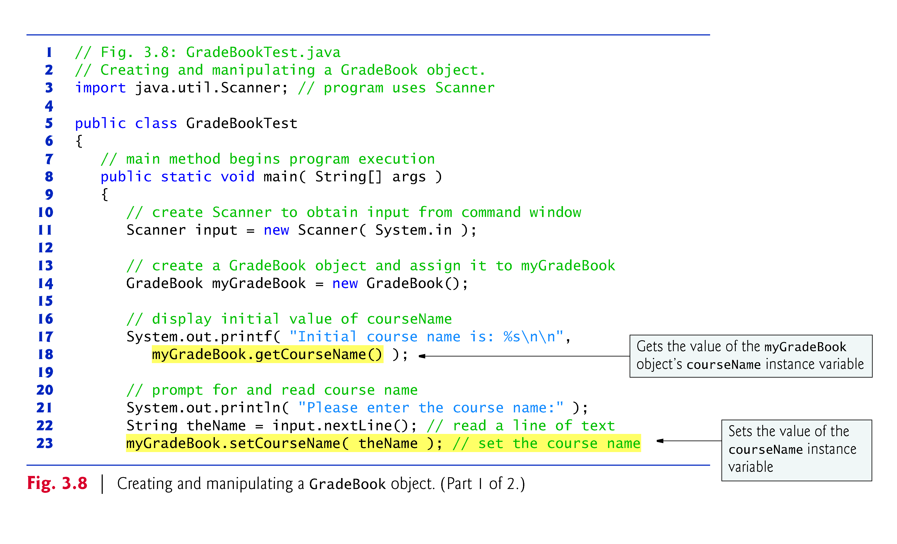

Slide 29
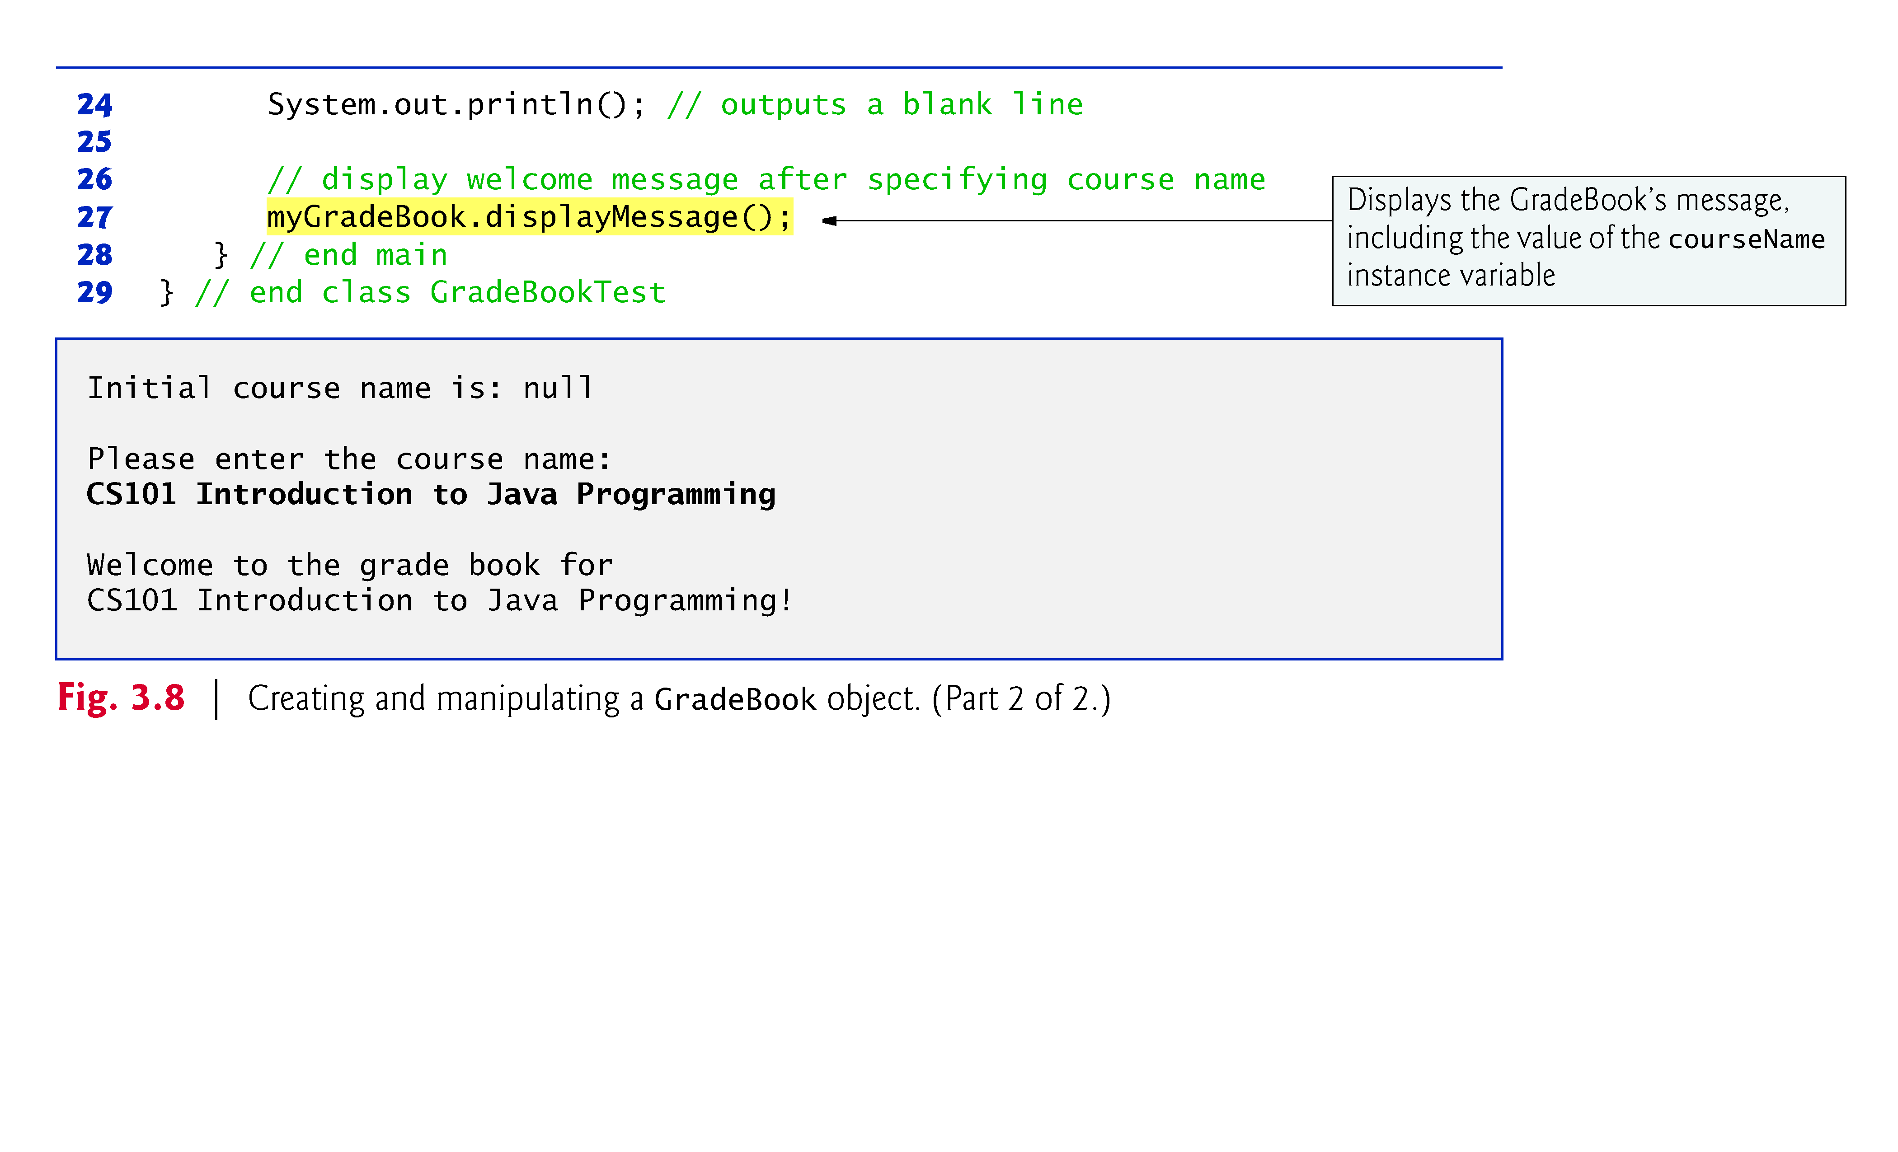

Slide 30
Instance Variables, set Methods and get Methods (Cont.)
set and get methods
  A class’s private fields can be manipulated only by the class’s methods.
  A client of an object calls the class’s public methods to manipulate the private fields of an object of the class.
  Classes often provide public methods to allow clients to set (i.e., assign values to) or get (i.e., obtain the values of) private instance variables.
  The names of these methods need not begin with set or get, but this naming convention is recommended.

Slide 31
Non-Primitive Data Types
Programs use variables of Non-Primitive types (normally called references) to store the locations of objects in the computer’s memory.
  Such a variable is said to refer to an object in the program.
Objects that are referenced may each contain many instance variables and methods.
Reference-type instance variables are initialized by default to the value null
  A reserved word that represents a “reference to nothing.”
When using an object of another class, a reference to the object is required to invoke (i.e., call) its methods.
  Also known as sending messages to an object.

Slide 32
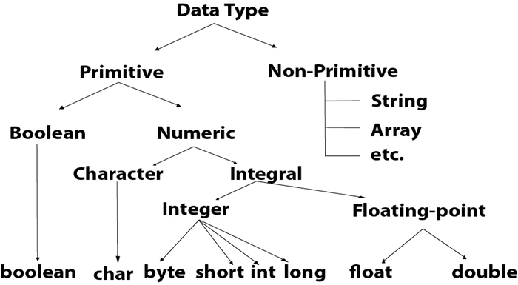
Non-Primitive Data Types
The non-primitive data types include Classes, Interfaces, and Arrays.

Slide 33
Initializing Objects with Constructors
When an object of a class is created, its instance variables are initialized by default.
Each class can provide a constructor that initializes an object of a class when the object is created.
Java requires a constructor call for every object that is created.
Keyword new requests memory from the system to store an object, then calls the corresponding class’s constructor to initialize the object.
A constructor must have the same name as the class.

Slide 34
Initializing Objects with Constructors (Cont.)
By default, the compiler provides a default constructor with no parameters in any class that does not explicitly include a constructor.
  Instance variables are initialized to their default values.
Can provide your own constructor to specify custom initialization for objects of your class.
A constructor’s parameter list specifies the data it requires to perform its task.
Constructors cannot return values, so they cannot specify a return type.
Normally, constructors are declared public.
If you declare any constructors for a class, the Java compiler will not create a default constructor for that class.

Slide 35
Constructors
A constructor initializes an object immediately upon creation.
It has the same name as the class in which it resides.
Once defined, the constructor is automatically called immediately after the object is created, before the new operator completes.
Constructors have no return type, not even void.
This is because the implicit return type of a class constructor is the class type itself.

Slide 36
Constructors
/* Here, Box uses a constructor to initialize the dimensions of a box.
*/
class Box {
double width;
double height;
double depth;
// This is the constructor for Box.
Box() { System.out.println("Constructing Box");
width = 10;
height = 10;
depth = 10;
}
// compute and return volume
double volume() {
return width * height * depth;
}
}
Program continues on next slide …

Slide 37
Constructors
class BoxDemo6 {
public static void main(String args[]) {
// declare, allocate, and initialize Box objects
Box mybox1 = new Box();
Box mybox2 = new Box();
double vol;
// get volume of first box
vol = mybox1.volume();
System.out.println("Volume is " + vol);
// get volume of second box
vol = mybox2.volume();
System.out.println("Volume is " + vol);
}
}
Constructing Box
Constructing Box
Volume is 1000.0
Volume is 1000.0

Slide 38
Constructors
When we don’t explicitly define a constructor for a class, then Java creates a default constructor for the class
The default constructor automatically initializes all instance variables to zero
Once we define our own constructor, the default constructor is no longer used

Slide 39
Parameterized Constructors
/* Here, Box uses a parameterized constructor to initialize the dimensions of a box.
*/
class Box {
double width;
double height;
double depth;
// This is the constructor for Box.
Box(double w, double h, double d) {
width = w;
height = h;
depth = d;
}
// compute and return volume
double volume() {
return width * height * depth;
}
}
Program continues on next slide …

Slide 40
Parameterized Constructors
class BoxDemo7 {
public static void main(String args[]) {
// declare, allocate, and initialize Box objects
Box mybox1 = new Box(10, 20, 15);
Box mybox2 = new Box(3, 6, 9);
double vol;
// get volume of first box
vol = mybox1.volume();
System.out.println("Volume is " + vol);
// get volume of second box
vol = mybox2.volume();
System.out.println("Volume is " + vol);
}
}
Volume is 3000.0
Volume is 162.0

Slide 41
The this keyword
Sometimes a method will need to refer to the object that invoked it.
To allow this, Java defines the this keyword.
this can be used inside any method to refer to the current object.
That is, this is always a reference to the object on which the method was invoked.

Slide 42
The this keyword
// A redundant use of this.
Box(double w, double h, double d) {
this.width = w;
this.height = h;
this.depth = d;
}

Slide 43
The this keyword
It is illegal in Java to declare two local variables with the same name inside the same or enclosing/nested scopes.
However, we can have local variables including formal parameters to methods, which overlap with the names of the class’ instance variables.
When a local variable has the same name as an instance variable, the local variable hides the instance variable.
This is why width, height, and depth were not used as the names of the parameters to the Box() constructor inside the box class.
this lets us refer directly to the object, we can use it to resolve any name space collisions that might occur between instance variables and local variables.

Slide 44
The this keyword
// Use this to resolve name-space collisions.
Box(double width, double height, double depth) {
this.width = width;
this.height = height;
this.depth = depth;
}

Slide 45
Garbage Collection
How the objects are destroyed and their memory released for later reallocation?
Java handles de-allocation automatically.
The technique that accomplishes this is called garbage collection.
It works like this:
  When no references to an object exist, that object is assumed to be no longer needed, and the memory occupied by the object can be reclaimed.
  Garbage collection only occurs occasionally during the execution of the program.
  It will not occur simply because one or more objects exist that are no longer used.

Slide 46
The finalize() Method
Sometimes an object will need to perform some action when it is destroyed.
Example: an object is holding some non-Java resource such as a file handle or window character font, then we might want to make sure these resources are freed before an object is destroyed.
To handle such situations Java provides a mechanism called finalization.
By using finalization, we can define specific action that will occur when an object is just about to be reclaimed by the garbage collector.

Slide 47
The finalize() Method
To add a finalizer to a class, we need to define the finalize() method.
The Java runtime calls that method whenever it is about to recycle an object of that class.
Inside the finalize method we will specify those actions that must be performed before an object is destroyed.
Right before an asset is freed, the Java runtime calls the finalize() method on the object.

Slide 48
The finalize() Method
The finalize() method has the following general form:
  protected void finalize()
  {
  //finalize code here
  }
finalize() is only called just prior to garbage collection.
It is not called when an object goes out of scope.
This means that we cannot know when or even if finalize() will be executed.

Slide 49
Package
Package in Java is a mechanism to encapsulate a group of classes, sub packages and interfaces.
Packages are used for: Preventing naming conflicts. For example there can be two classes with name Employee in two packages, college.
A protected member is accessible by classes in the same package and its subclasses

Slide 50
Java naming conventions
Java naming convention is a rule to follow as you decide what to name your identifiers such as class, package, variable, constant, method, etc.
But, it is not forced to follow. So, it is known as convention not rule. These conventions are suggested by several Java communities such as Sun Microsystems and Netscape.
All the classes, interfaces, packages, methods and fields of Java programming language are given according to the Java naming convention.
If you fail to follow these conventions, it may generate confusion or erroneous code.

Slide 51
Advantage of Naming Conventions in Java
By using standard Java naming conventions, you make your code easier to read for yourself and other programmers.
Readability of Java program is very important.
It indicates that less time is spent to figure out what the code does.

Slide 52
identifiers Type | Naming Rules | Examples
Class | It should start with the uppercase letter. It should be a noun such as Color, Button, System, Thread, etc. Use appropriate words, instead of acronyms. | public class Employee { //code snippet }
Interface | It should start with the uppercase letter. It should be an adjective such as Runnable, Remote, ActionListener. Use appropriate words, instead of acronyms. | interface Printable { //code snippet }
Method | It should start with lowercase letter. It should be a verb such as main(), print(), println(). If the name contains multiple words, start it with a lowercase letter followed by an uppercase letter such as actionPerformed(). | class Employee { // method void draw() { //code snippet } }

Slide 53
Variable | It should start with a lowercase letter such as id, name. It should not start with the special characters like & (ampersand), $ (dollar), _ (underscore). If the name contains multiple words, start it with the lowercase letter followed by an uppercase letter such as firstName,lastName. Avoid using one-character variables such as x, y, z. | class Employee { // variable int id; //code snippet }
Package | It should be a lowercase letter such as java, lang. If the name contains multiple words, it should be separated by dots (.) such as java.util, java.lang. | //package package com.javatpoint; class Employee { //code snippet }
Constant | It should be in uppercase letters such as RED, YELLOW. If the name contains multiple words, it should be separated by an underscore(_) such as MAX_PRIORITY. It may contain digits but not as the first letter. | class Employee { //constant static final int MIN_AGE = 18; //code snippet }

Slide 54
CamelCase in Java naming conventions
Java follows camel-case syntax for naming the class, interface, method, and variable.
If the name is combined with two words, the second word will start with uppercase letter always such as actionPerformed(), firstName, ActionEvent, ActionListener, etc.

Slide 55
Java Date
Java does not have a built-in Date class, but we can import the java.time package to work with the date and time API.
The package includes many date and time classes.
For example:
Class | Description
LocalDate | Represents a date (year, month, day (yyyy-MM-dd))
LocalTime | Represents a time (hour, minute, second and nanoseconds (HH-mm-ss-ns))
LocalDateTime | Represents both a date and a time (yyyy-MM-dd-HH-mm-ss-ns)
DateTimeFormatter | Formatter for displaying and parsing date-time objects

Slide 56
Display Current Date
To display the current date, import the java.time.LocalDate class,
and use its now() method:
import java.time.LocalDate; // import the LocalDate class
public class Main {
public static void main(String[] args)
{
LocalDate myObj = LocalDate.now(); // Create a date object
System.out.println(myObj); // Display the current date
}
}

Slide 57
Import Keyword
The import keyword is used to import a package, class or interface.
Example
Import the Scanner class from the Java API:
import java.util.Scanner;
class MyClass
{
public static void main(String[] args)
{
Scanner myObj = new Scanner(System.in);
System.out.println("Enter username");
String userName = myObj.nextLine();
System.out.println("Username is: " + userName);
}
}

Slide 58
Deprecation
The @Deprecated annotation tells the compiler that a method, class, or field is deprecated and that it should generate a warning if someone tries to use it.
That's what a deprecated class or method is. It's no longer relevant.
Example:
@Deprecated
  public int calculate(Machine machine)
  {
  return machine.exportVersions().size() * 10;
  }

Slide 59
Documentation
Javadoc (originally cased JavaDoc) is a documentation generator created by Sun Microsystems for the Java language (now owned by Oracle Corporation) for generating API documentation in HTML format from Java source code.
Writing comments and Javadoc is for better understanding the code and thus better maintaining it.

Slide 60
String Handling
Strings are used for storing text.
A String variable contains a collection of characters surrounded by double quotes:
Example : Create a variable of type String and assign it a value
String greeting = "Hello";

Slide 61
String Handling
String literals are represented as a sequence of characters surrounded by double quotes and a character literal is represented as a single character surrounded by single quotes.
Java also allows use of escape sequences in string and character literals.
For example, \b (backspace), \t (tab), \n (line feed), \f (form feed), \r (carriage return), \” (double quote), \’ (single quote), and \\ (backslash).

Slide 62
String Object
String is sequence of characters.
Unlike many other programming languages that implements string as character arrays, Java implements strings as object of type String.
This provides a full compliment of features that make string handling convenient. For example, Java String has methods to:
  compare two strings.
  Search for a substring.
  Concatenate two strings.
  Change the case of letters within a string.
  Can be constructed a number of ways making it easy to obtain a string when needed.

Slide 63
String is Immutable
Once a String Object has been created, you cannot change the characters that comprise that string.
This is not a restriction. It means each time you need an altered version of an existing string, a new string object is created that contains the modification.
It is more efficient to implement immutable strings than changeable ones.
To solve this, Java provides a companion class to String called StringBuffer.
StringBuffer objects can be modified after they are created.

Slide 64
String Constructors 1
String supports several constructors:
1) to create an empty String
String s = new String();
To create a String initialized by an array of characters, use the constructor shown here.
2) to create a string that have initial values
String(char chars[])
This constructor initializes s with the string “abc”.
Example:
char chars[] = {‘a’,’b’,’c’};
String s = new String(chars);

Slide 65
String Constructors 2
3) To create a string as a subrange of a character array
String(char chars[], int startindex, int numchars)
Here, startindex specifies the index at which the subrange begins,
and numChars specifies the number of characters to use.
Example:
char chars[] = {‘a’,’b’,’c’,’d’,’e’,’f’};
String s = new String(chars,2,3);
This initializes s with the characters code.

Slide 66
String Constructors 3
4) To construct a String object that contains the same character sequence
as another String object
String(String obj)
Example:
class MakeString {
public static void main(String args[]) {
char c[] = {'J', 'a', 'v', 'a'};
String s1 = new String(c);
String s2 = new String(s1);
System.out.println(s1);
System.out.println(s2);
The output from this program is as follows:
Java
Java
}
}

Slide 67
String Length
The length of a string is the number of characters that it contains.
To obtain this value call the length()method:
int length();
The following fragment prints “3”, since there are three characters in the
string s.
char chars[] = {‘a’,’b’,’c’};
String s = new String(chars);
System.out.println(s.lenght());

Slide 68
String Operations
Strings are a common and important part of programming.
Java provides several string operations within the syntax of the language.
These operations include:
1) automatic creation of new String instances from literals
2) concatenation of multiple String objects using the + operator
3) conversion of other data types to a string representation
There are explicit methods to perform all these functions, but Java does them automatically for the convenience of the programmer and to add clarity.

Slide 69
String Concatenation
Java does not allow operators to be applied to a String object.
The one exception to this rule is the + operator, which concatenates two
strings producing a string object as a result.
With this you to chain together a series of + operations.
Example:
String age = “9”;
String s = “He is ” + age + “ years old.”;
System.out.println(s);

Slide 70
Concatenation & Other Data Type
You can concatenate Strings with other data types.
Example:
int age = 9;
String s = “He is ” + age + “ years old.”;
System.out.println(s);
The compiler will convert an operand to its string equivalent whenever the
other operand of the + ia an instance of String.
Be careful:
String s = “Four:” + 2 + 2;
System.out.println(s);
Prints Four:22 rather than Four: 4.
To achieve the desired result, bracket has to be used.
String s = “Four:” + (2 + 2);

Slide 71
Conversion and toString() Method
When Java converts data into its string representation during concatenation,
it does so by calling one of its overloaded valueOf() method defined by
String.
valueOf() is overloaded for
1) simple types – which returns a string that contains the human –
readable equivalent of the value with which it is called.
2) object types – which calls the toString() method of the object.

Slide 72
Example: toString() Method 1
Override toString() for Box class
class Box {
double width;
double height;
double depth;
Box(double w, double h, double d) {
width = w;
height = h;
depth = d;
}

Slide 73
Example: toString() Method 2
public String toString() {
return "Dimensions are " + width + " by " +
depth + " by " + height + ".";
}
}
If we have to convert an whole object to string then overload its method.

Slide 74
Example: toString() Method 3
class toStringDemo {
public static void main(String args[]) {
Box b = new Box(10, 12, 14);
String s = "Box b: " + b; // concatenate Box object
System.out.println(b); // convert Box to string (Dimension is 10 by 12 by 14)
System.out.println(s); // (Box b: Dimension is 10 by 12 by 14)
}
}
Box’s toString() method is automatically invoked when a Box object is used in a concatenation expression or in a Call to println().

Slide 75
Character Extraction
String class provides a number of ways in which characters can be extracted from a String object.
String index begin at zero.
These extraction methods are:
1) charAt()
2) getChars()
3) getBytes()
4) toCharArray()
Each will considered.

Slide 76
charAt()
To extract a single character from a String.
General form:
char charAt(int where (at which index) )
where is the index of the character you want to obtain. The value of where must be nonnegative and specify alocation within the string.
Example:
char ch;
ch = “abc”.charAt(1);
Assigns a value of “b” to ch.

Slide 77
getChars()
Used to extract more than one character at a time.
General form:
void getChars(int sourceStart, int sourceEnd, char[]
target, int targetStart)
sourceStart – specifies the index of the beginning of the substring
sourceEnd – specifies an index that is one past the end of the desired subString
target – is the array that will receive the characters
targetStart – is the index within target at which the subString will be copied is passed in this parameter

Slide 78
getChars()
class getCharsDemo {
public static void main(String args[]) {
String s = "This is a demo of the getChars method.";
int start = 10;
int end = 14;
char buf[] = new char[end - start];
s.getChars(start, end, buf, 0);
System.out.println(buf);
}
}
Output :
This

Slide 79
String Comparison
The String class includes several methods that compare strings or substrings
within strings.
They are:
1) equals() and equalsIgnoreCase()
2) regionMatches()
3) startWith() and endsWith()
4) equals() Versus ==
5) comapreTo()
Each will be considered.

Slide 80
equals()
To compare two Strings for equality, use equals()
General form:
boolean equals(Object str);
str is the String object being compared with the invoking String object.
It returns true if the string contain the same character in the same order, and
false otherwise.
The comparison is case-sensitive.

Slide 81
equals and equalsIgnoreCase() 1
Example:
class equalsDemo {
public static void main(String args[]) {
String s1 = "Hello";
String s2 = "Hello";
String s3 = "Good-bye";
String s4 = "HELLO";
System.out.println(s1 + " equals " + s2 + " -> " +
s1.equals(s2));
System.out.println(s1 + " equals " + s3 + " -> " +
s1.equals(s3));

Slide 82
equals and equalsIgnoreCase() 2
System.out.println(s1 + " equals " + s4 + " -> " +
s1.equals(s4));
System.out.println(s1 + " equalsIgnoreCase " + s4 +
" -> " + s1.equalsIgnoreCase(s4));
}
}
Output:
Hello equals Hello -> true
Hello equals Good-bye -> false
Hello equals HELLO -> false
Hello equalsIgnoreCase HELLO -> true

Slide 83
StartsWith() and endsWith() 1
String defines two routines that are more or less the specialised forms of regionMatches().
The startsWith() method determines whether a given string begins with
a specified string.
Conversely, endsWith() method determines whether the string in question
ends with a specified string.
General form:
boolean startsWith(String str)
boolean endsWith(String str)
str is the String being tested. If the string matches, true is returned,
otherwise false is returned.

Slide 84
startsWith() and endsWith() 2
Example:
“Foobar”.endsWith(“bar”);
and
“Foobar”.startsWith(“Foo”);
are both true.

Slide 85
Searching String 1
String class provides two methods that allows you search a string for a specified character or substring:
1) indexOf() – Searches for the first occurrence of a character or
substring.
2) lastIndexOf() – Searches for the last occurrence of a charater or
substring.
These two methods are overloaded in several different ways. In all cases, the methods return the index at which the character or substring was found, or -1 on failure.

Slide 86
Modifying a String
String object are immutable.
Whenever you want to modify a String, you must either copy it into a
StringBuffer or use the following String methods,, which will construct a new
copy of the string with your modification complete.
They are:
1) subString()
2) concat()
3) replace()
4) trim()
Each will be discussed.

Slide 87
subString() 1
You can extract a substring using subString().
It has two forms:
String substring(int startIndex)
startIndex specifies the index at which the substring will begin. This form
returns a copy of the substring that begins at startIndex and runs to the end
of the invoking string.

Slide 88
subString() 2
The second form allows you to specify both the beginning and ending index of the substring.
String substring(int startIndex, int ensIndex)
startIndex specifies the index beginning index, and
endIndex specifies the stopping point.
The string returned contains all the characters from the beginning index, up
to, but not including, the ending index.

Slide 89
Example: subString()
class StringReplace {
public static void main(String args[]) {
String org = "This is a test. This is, too.";
String search = "is";
String sub = "was";
String result = "";
int i;
do { // replace all matching substrings
System.out.println(org);
i = org.indexOf(search);
if(i != -1) {
result = org.substring(0, i);

Slide 90
Example: subString()
result = result + sub;
result = result + org.substring(i +
search.length());
org = result;
}
} while(i != -1);
The output from this program is shown here:
This is a test. This is, too.
Thwas is a test. This is, too.
Thwas was a test. This is, too.
Thwas was a test. Thwas is, too.
Thwas was a test. Thwas was, too.
}
}

Slide 91
concat()
You can concatenate two string using concat()
General form:
String concat(String str)
This method creates a new object that contains the invoking string with the
contents of str appended to the end.
concat() performs the same function as +.
Example:
String s1 =“one”;
String s2 = s1.concat(“two”);
Or
String s2 = s1 + “two”;

Slide 92
Replace()
Replaces all occurences of one character in the invoking string with another character.
General form:
String replace(char original, char replacement)
original – specifies the character to be replaced by the character specified by replacement. The resulting string is returned.
Example:
String s = “Hello”.replace(‘l’,’w’);
Puts the string “Hewwo” into s.

Slide 93
trim()
Returns a copy of the involving string from which any leading and trailing whitespace has been removed.
General form:
String trim();
Example:
String s = “
Hello world ”
.trim();
This puts the string “Hello world” into s.
It is quite useful when you process user commands.

Slide 94
Case of Characters
The method toLowerCase() converts all the characters in a string from uppercase to lowercase.
The toUpperCase() method converts all the characters in a string from lowercase to uppercase.
Non-alphabetical characters, such as digits are unaffected.
General form:
String toLowercase()
String toUppercase()

Slide 95
Example: Case of Characters
class ChangeCase {
public static void main(String args[]) {
String s = "This is a test.";
System.out.println("Original: " + s);
String upper = s.toUpperCase();
String lower = s.toLowerCase();
System.out.println("Uppercase: " + upper);
System.out.println("Lowercase: " + lower);
}
}
The output produced by the program is shown here:
Original: This is a test.
Uppercase: THIS IS A TEST.
Lowercase: this is a test.

Slide 96
StringBuffer
StringBuffer is a peer class of string that provides much of the functionality of Strings.
String is immutable. StringBuffer represents growable and writable character sequence.
StringBuffer may have characters and substring inserted in the middle or appended to the end.
StringBuffer will automatically grow to make room for such additions and often has more characters preallocated than are actually needed, to allow room for growth.

Slide 97
StringBuffer Constructors
Defines three constructors:
1) StringBuffer() – default and reserves room for 16 characters without
reallocation.
2) StringBuffer(int size) – accepts an integer argument that
explicitly sets the size of the buffer.
3) StringBuffer(String str) – accepts a String argument that initially sets the content of the StringBuffer object and reserves room for more 16 characters without reallocation.

Slide 98
Length() and capacity()
Current length of a StringBuffer can be found via the length() method, while the total allocated capacity can be found throught the capacity() method.
General form:
int length()
Int capacity()

Slide 99
Example: Length() and capacity()
class StringBufferDemo {
public static void main(String args[]) {
StringBuffer sb = new StringBuffer("Hello");
System.out.println("buffer = " + sb);
System.out.println("length = " + sb.length());
System.out.println("capacity = " + sb.capacity());
}
}
Output:
buffer = Hello
length = 5
capacity = 21

Slide 100
ensureCapacity()
Use ensureCapacity() to set the size of the buffer in order to reallocate room for a certain number of characters after a StringBuffer has been constructed.
General form:
void ensureCapacity(int capacity)
Here, capacity specifies the size of the buffer.
Usage:
Useful if you know in advance that you will be appending a large number of small strings to a StringBuffer.

Slide 101
setLength()
To set the length of the buffer within a StringBuffer object.
General form:
void setlength (int len)
Here, len specifies the lenght of the buffer.
Usage:
When you increase the length of the buffer, null characters are added to the end of the existing buffer. If you call setLength() with a value less than the current value returned by length(), then the characters stored beyond the new length will be lost.

Slide 102
insert()
Inserts one string into another. It is overloaded to accept values of all the
simple types, plus String and Objects.
General form:
StringBuffer insert(int index, String str)
StringBuffer insert(int index, char ch)
StringBuffer insert(int index, Object obj)
Here, index specifies the index at which point the String will be inserted
into the invoking StringBuffer object.

Slide 103
Example: insert()
class insertDemo {
public static void main(String args[]) {
StringBuffer sb = new StringBuffer("I Java!");
sb.insert(2, "like ");
System.out.println(sb);
}
}
The output of this example is shown here:
I like Java!

Slide 104
reverse()
To reverse the character within a StringBuffer object.
General form:
StringBuffer reverse()
This method returns the reversed on which it was called.
For example:
class ReverseDemo {
public static void main(String args[]) {
StringBuffer s = new StringBuffer("abcdef");
System.out.println(s);
s.reverse();
Here is the output produced by the program:
abcdef
fedcba
System.out.println(s);
}
}

Slide 105
replace()
Replaces one set of characters with another set inside a StringBuffer object.
General form:
StringBuffer replace(int startIndex, String endIndex,
String str)
The substring being replaced is specified by the indexes startIndex and endIndex. Thus, the substring at startIndex through endIndex-1 is replaced. The replacement string is passed in str. The resulting StringBuffer object is returned.

Slide 106
Example: replace()
class replaceDemo {
public static void main(String args[]) {
StringBuffer sb = new StringBuffer("This is a
test.");
sb.replace(5, 7, "was");
System.out.println("After replace: " + sb);
}
}
Here is the output:
After replace: This was a test.

Slide 107
StringTokenizer
The java.util.StringTokenizer class allows an application to break a string into tokens.
The StringTokenizer constructors are shown here:
StringTokenizer(String str)
StringTokenizer(String str, String delimiters)
StringTokenizer(String str, String delimiters, boolean delimAsToken)

Slide 108
StringTokenizer
// Demonstrate StringTokenizer.
import java.util.StringTokenizer;
class STDemo {
static String in = "title=Java: The Complete Reference;" + "author=Schildt;" + "publisher=Osborne/McGraw-Hill;" + "copyright=2002";
public static void main(String args[]) {
StringTokenizer st = new StringTokenizer(in, "=;");
while(st.hasMoreTokens()) {
String key = st.nextToken();
String val = st.nextToken();
System.out.println(key + "\t" + val);
}
}
}
The output from this program is shown here:
title Java: The Complete Reference
author Schildt
publisher Osborne/McGraw-Hill
copyright 2002

Slide 109
S.N. | Method & Description
1 | int countTokens() This method calculates the number of times that this tokenizer's nextToken method can be called before it generates an exception.
2 | boolean hasMoreElements() This method returns the same value as the hasMoreTokens method.
3 | boolean hasMoreTokens() This method tests if there are more tokens available from this tokenizer's string.
4 | Object nextElement() This method returns the same value as the nextToken method, except that its declared return value is Object rather than String.
5 | String nextToken() This method returns the next token from this string tokenizer.
6 | String nextToken(String delim) This method returns the next token in this string tokenizer's string.

Slide 110
Recommended Readings
Chapter # 6: Introducing Classes from Herbert Schildt, Java: The Complete Reference, J2SETM 5 Edition

